Slide 1
How do salary, application volume, and job visibility vary across the top 10 most-applied job titles and how do they influence each other?
By
YAN MYOE NAING
DAAA/FT/1B/05

Slide 2
Summary of Steps Taken
1. Importing Files, Modules and Packages¶
2. Processing the Data
3. Dataset Refinement for Question
4. Graphical Analysis
5. Final Reflection

Slide 3
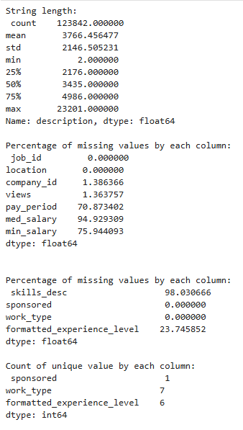
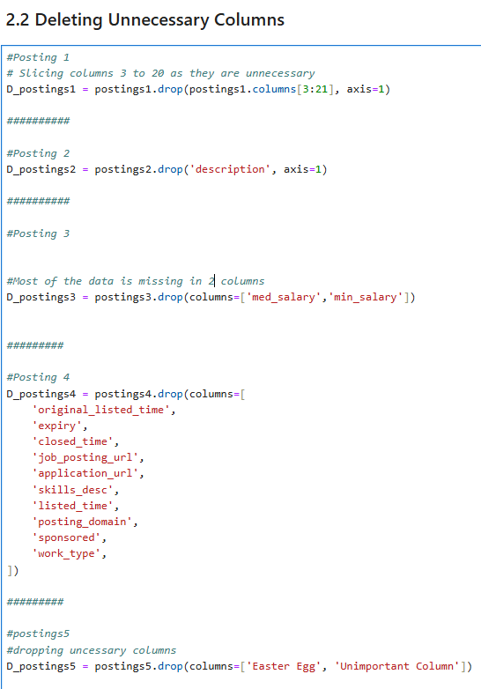
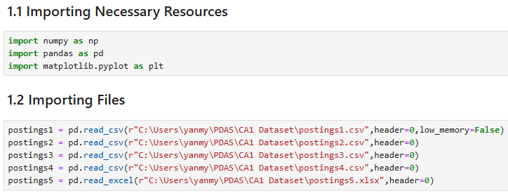
Pandas: Importing & Processing Data
Import numpy, pandas, matplotlibs
Check the stats of the dataframe
Delete unnecessary/unrelated columns
Delete columns with so many missing values
Delete Duplicated Columns (formatted tables)
Delete parsing failure columns (time columns)
Delete columns with single values (sponsored)

Slide 4
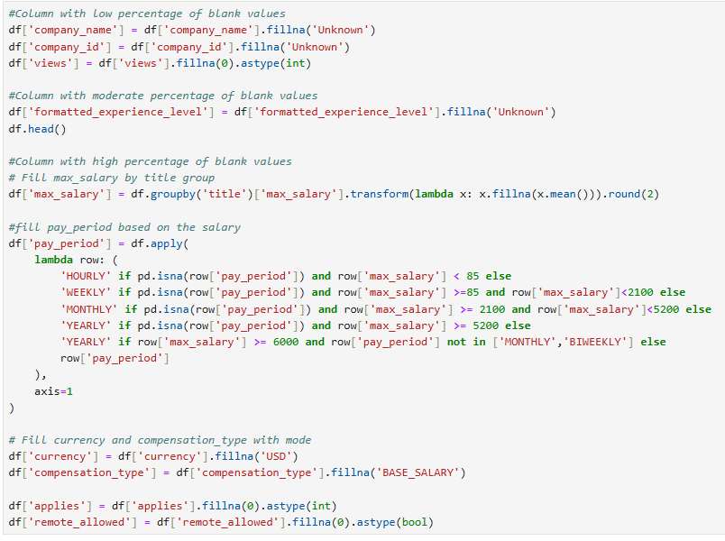
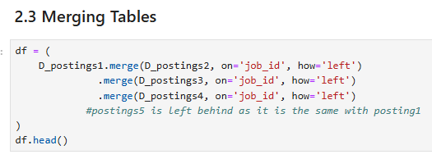
Pandas: Processing Data
Merge all tables (except posting5 as it contains the same data with posting 1 )
Handling Missing Values
Low missingness (<2%)
  company_name, company_id → "Unknown"
  views → 0 (integer)
Moderate missingness (~20–25%)
  formatted_experience_level → "Unknown“
. High missingness (>75%)
  max_salary → mean within job title
  currency → "USD"
  compensation_type → "BASE_SALARY"
Rule-based imputation
  <85 → HOURLY
  <2100 → WEEKLY
  >2100 → MONTHLY
  ≥5200 → YEARLY
  Biweekly rare → assumed specific jobs
  Extreme hourly/weekly → corrected to YEARLY
Very high missingness but interpretable
  applies → 0 (integer)
  remote_allowed → 0 (boolean)

Slide 5
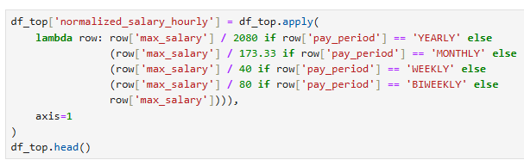
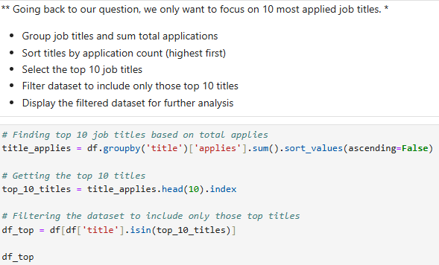
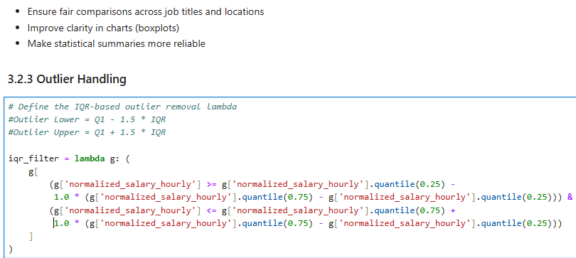
Dataset Refinement for Question
Normalizing Salary to Hourly Rate
Assumption: 40 hours/week
- Yearly ÷ 2080
- Monthly ÷ 173.33
- Weekly ÷ 40
- Biweekly ÷ 80
- Hourly left unchanged
Filtering the Necessary Data
Focus only on Top 10 most-applied job titles
- Group job titles and sum total applications
- Sort by application count (highest first)
- Select top 10 titles
- Filter dataset to include only those titles
- Use this subset for further analysis
Why Remove Outliers?
Outliers distort averages and compress visualizations
- Removing them ensures:
- Fair comparisons across job titles and locations
- Clearer charts (e.g., boxplots)
- Lower bound = Q1 − 1.5 × IQR
- Upper bound = Q3 + 1.5 × IQR

Slide 6
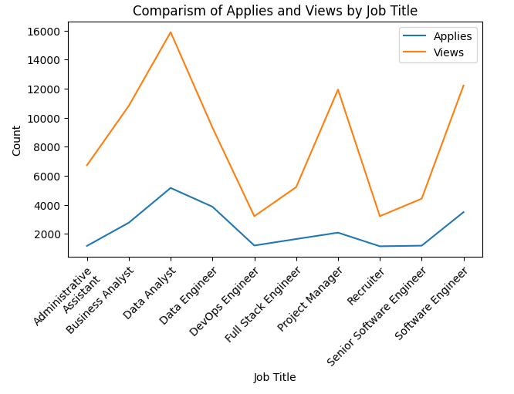
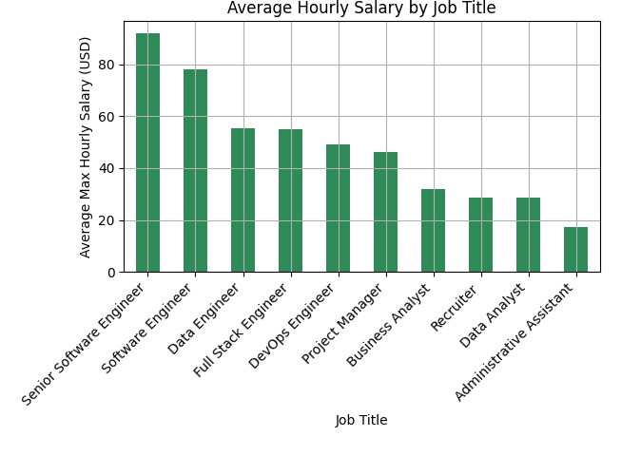
4. Graphical Analysis
Applies vs Views by Job Title
Views inconsistently exceed applications
Data Analyst and Software Engineer show high views and strong application volume
Administrative Assistant and Recruiter have lower engagement overall
Helps identify which roles attract attention vs. which roles get more application
Applies vs Views by Job Title
Senior Software Engineer and Software Engineer lead with the highest average pay.
Technical roles like Data Engineer and Full Stack Engineer consistently rank above business or support roles.
Administrative Assistant and Recruiter show the lowest average salaries, reflecting market demand.

Slide 7
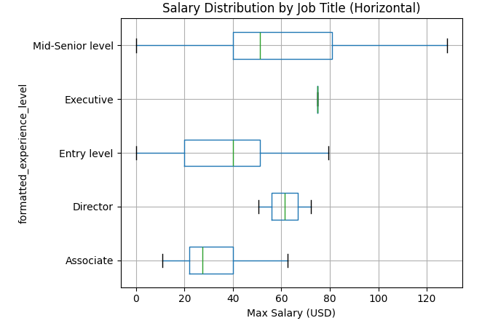
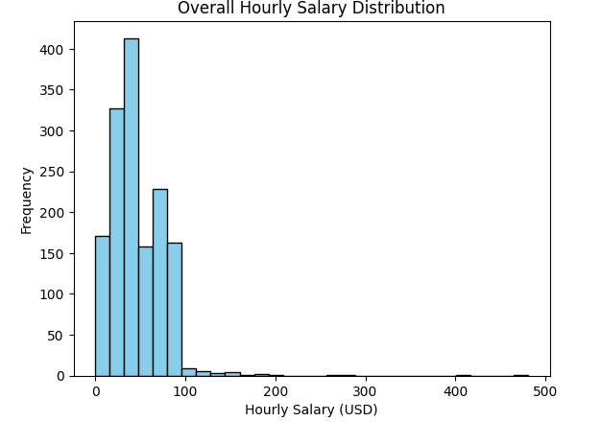
4. Graphical Analysis
Salary Distribution by Job Title
This boxplot compares salary ranges across five experience levels:
Executive: Highest median and smallest spread.
Mid-Senior level: Strong median with widest variability.
Associate: Lowest median salary with tighter range.
Entry level: Low median and wide spread.
Director: Tight salary range, but high median pay.
Outliers were removed using IQR filtering to ensure fair comparison and clearer visualization.
Overall Hourly Salary Distribution
This histogram shows how hourly salaries are distributed across all jobs:
Most salaries fall between 0 and 100
Concentration with the highest frequency around 40 and 50.
Salaries above $100/hour are rare
The distribution is right-skewed

Slide 8
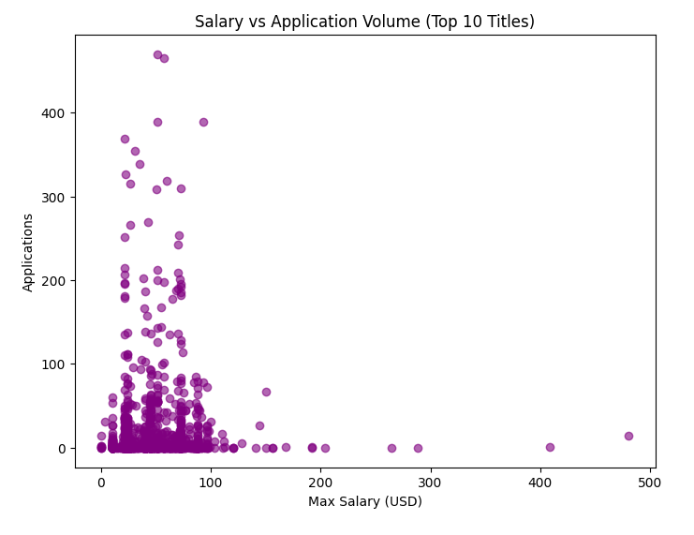
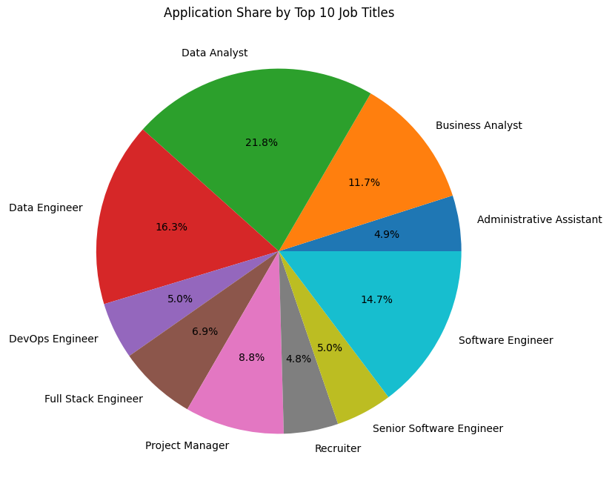
4. Graphical Analysis
Application Share by Top 10 Job Titles
This pie chart shows how applications are distributed across the top 10 job titles.
Data Analyst dominates with over 20% of total applications.
Software Engineer and Data Engineer also attract high volumes.
Roles like Recruiter and Administrative Assistant receive fewer applications.
Salary vs Application Volume
Most applications cluster around jobs below $100/hours
Higher interest in mid-range roles.
As salary increases, application volume tends to drop, possibly due to stricter qualifications.
The spread shows no strong linear correlation, indicating that salary alone doesn't drive application volume.

Slide 9
5. Final Reflection
Salary
Tech roles (Software Engineer, Data Engineer) pay the most
Senior roles (Executive, Director) also high
Entry-level/support roles pay less
Applications
Data Analyst gets the most, followed by Software Engineer
Lower-paying or highly specialized jobs attract fewer applicants
Views vs Applications
Jobs are viewed more than applied to
High-paying jobs get attention but fewer applications (strict requirements)
Salary vs Applications
Higher pay ≠ more applications
Mid-range jobs attract the most applicants (accessible + decent pay)
Overall Insight
Salary, visibility, and job type all shape applicant behavior
High pay draws interest but not always applications
Mid-range roles generate most applications
Visibility shows interest, but applications depend on role accessibility

